Slide 1
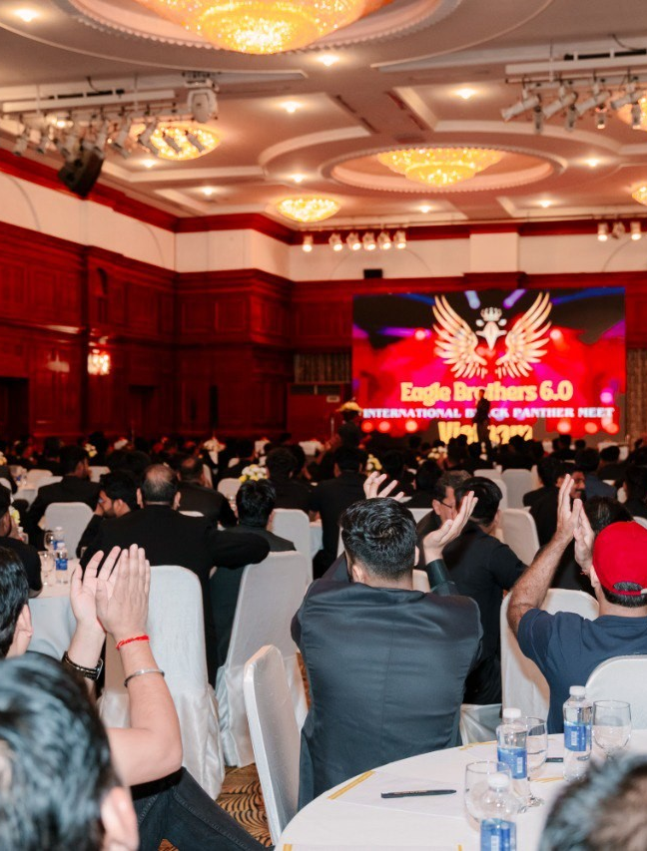
OUTRISE ENTERPRISES
Customer conversations & team follow-through
A practical guide to understanding needs, handling objections and building a repeatable process.
Portfolio training sample · 01 / 06
Notes:
New Outrise portfolio training sample adapted from creator-provided Event presentation 2.pdf (needs discovery, product knowledge, rejection and systems) and Leadership.pdf (team training). Business process applications are new adaptations, not historical client results. Event photographs show historical event participation, not client endorsements.

Slide 2
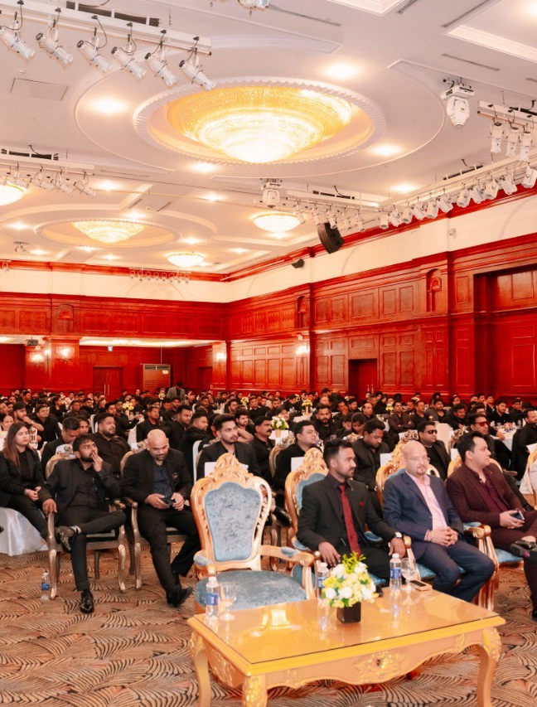
OUTRISE ENTERPRISES
Understand the need before the pitch
Ask how the customer manages the work today.
Find the repeated task, missed follow-up or unclear handoff.
Agree what a useful outcome would look like.
Portfolio training sample · 02 / 06
Notes:
New Outrise portfolio training sample adapted from creator-provided Event presentation 2.pdf (needs discovery, product knowledge, rejection and systems) and Leadership.pdf (team training). Business process applications are new adaptations, not historical client results. Event photographs show historical event participation, not client endorsements.

Slide 3
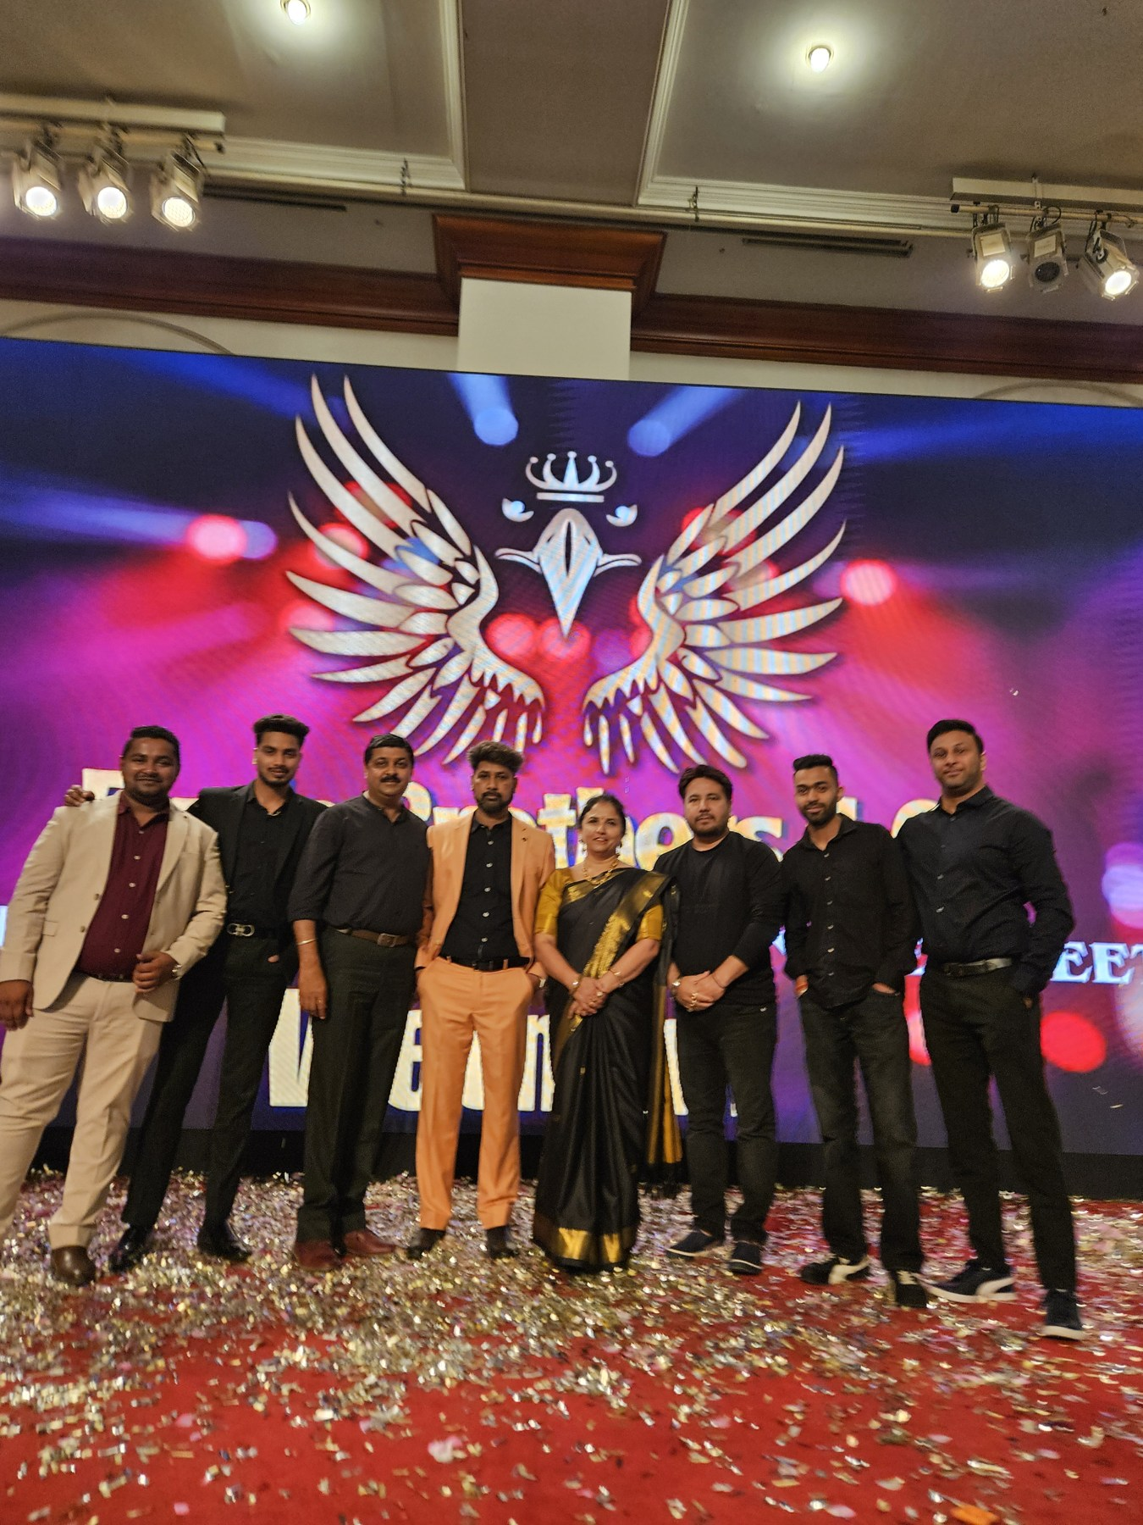
OUTRISE ENTERPRISES
Explain the solution in their context
Know the process and the tools before recommending a change.
Use an example that matches the customer’s situation.
Explain what people will still review or decide.
Portfolio training sample · 03 / 06
Notes:
New Outrise portfolio training sample adapted from creator-provided Event presentation 2.pdf (needs discovery, product knowledge, rejection and systems) and Leadership.pdf (team training). Business process applications are new adaptations, not historical client results. Event photographs show historical event participation, not client endorsements.

Slide 4
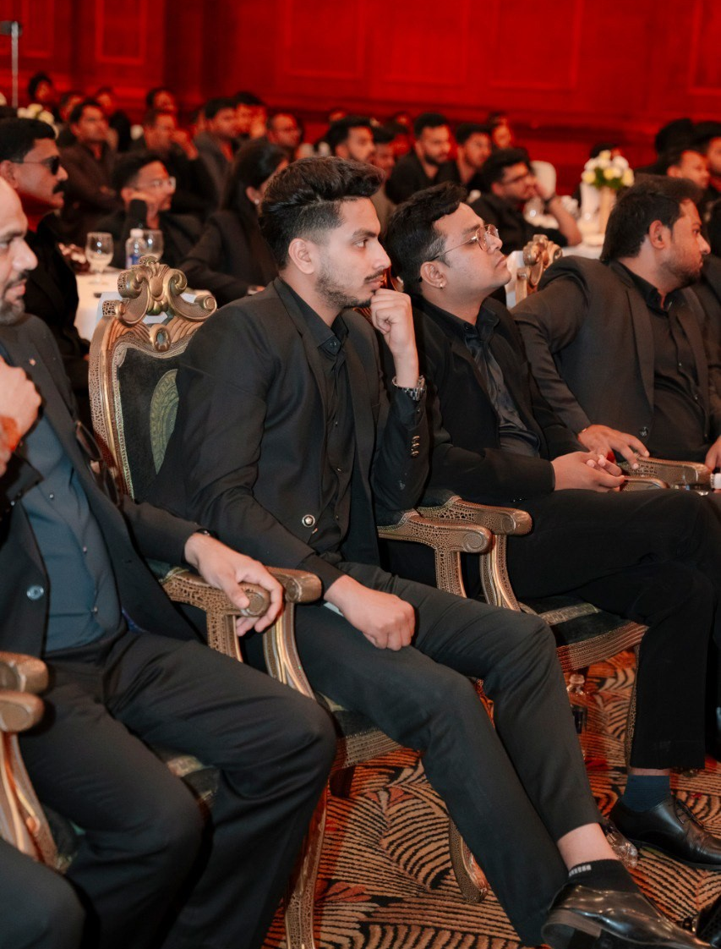
OUTRISE ENTERPRISES
Handle objections with a clear next step
Listen to the concern and ask what is missing.
Respond with the relevant information rather than a bigger promise.
Record the decision and agree whether to follow up.
Portfolio training sample · 04 / 06
Notes:
New Outrise portfolio training sample adapted from creator-provided Event presentation 2.pdf (needs discovery, product knowledge, rejection and systems) and Leadership.pdf (team training). Business process applications are new adaptations, not historical client results. Event photographs show historical event participation, not client endorsements.

Slide 5
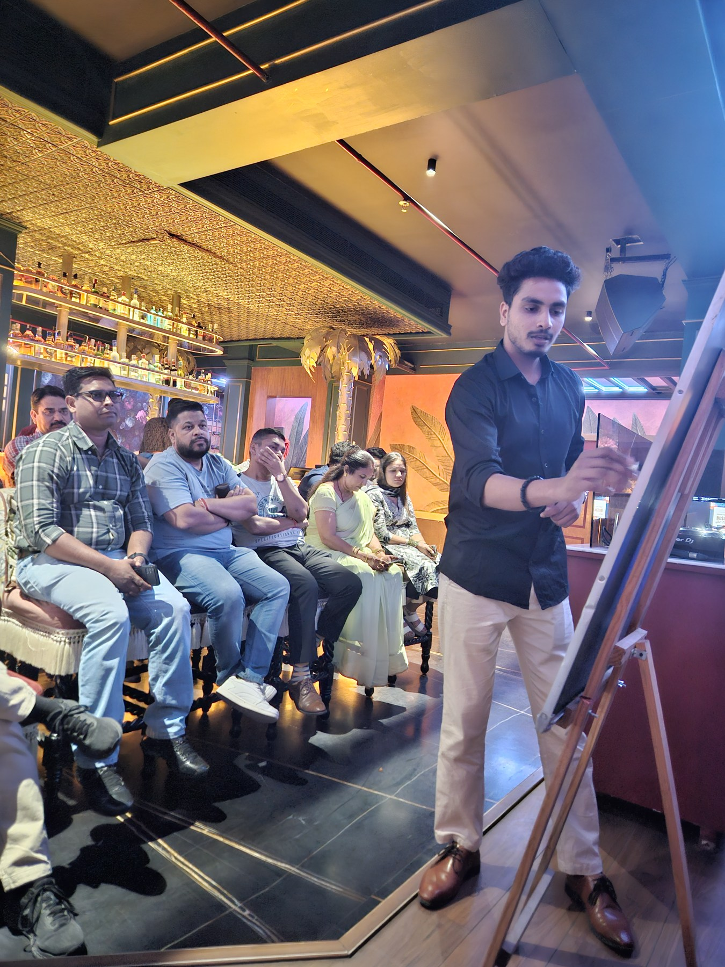
OUTRISE ENTERPRISES
Make follow-through repeatable
Capture the enquiry in one working list.
Record interest and assign the next action.
Check that completed steps are handed over to the right person.
Portfolio training sample · 05 / 06
Notes:
New Outrise portfolio training sample adapted from creator-provided Event presentation 2.pdf (needs discovery, product knowledge, rejection and systems) and Leadership.pdf (team training). Business process applications are new adaptations, not historical client results. Event photographs show historical event participation, not client endorsements.

Slide 6

OUTRISE ENTERPRISES
Help the team use the process
Explain the stages in plain language.
Practise common conversations and handoffs together.
Review feedback and update the process when something is unclear.
Portfolio training sample · 06 / 06
Notes:
New Outrise portfolio training sample adapted from creator-provided Event presentation 2.pdf (needs discovery, product knowledge, rejection and systems) and Leadership.pdf (team training). Business process applications are new adaptations, not historical client results. Event photographs show historical event participation, not client endorsements.

